Slide 1

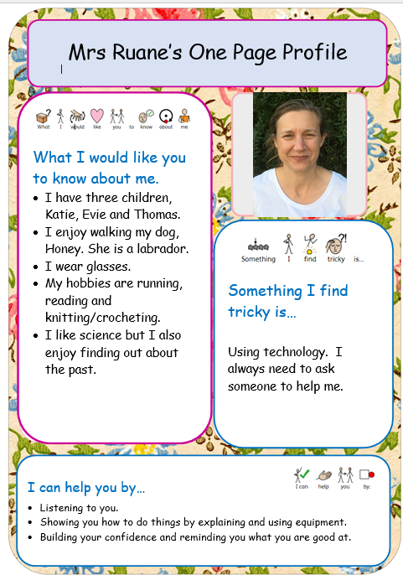

Slide 2
Elijah Class - Year 2
Key stage 1
Curriculum Presentation 2025
‘Encourage and Support’

Slide 3
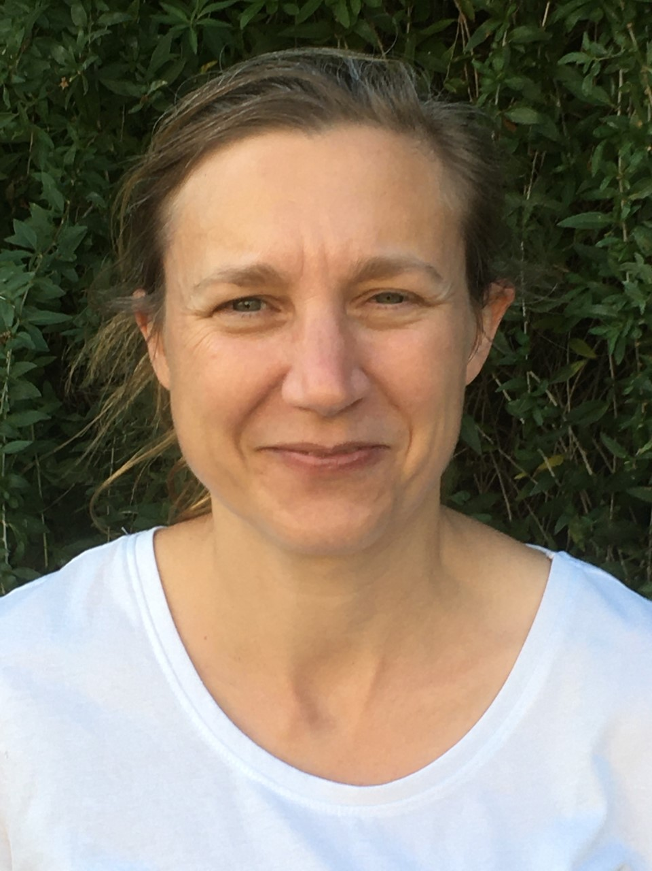
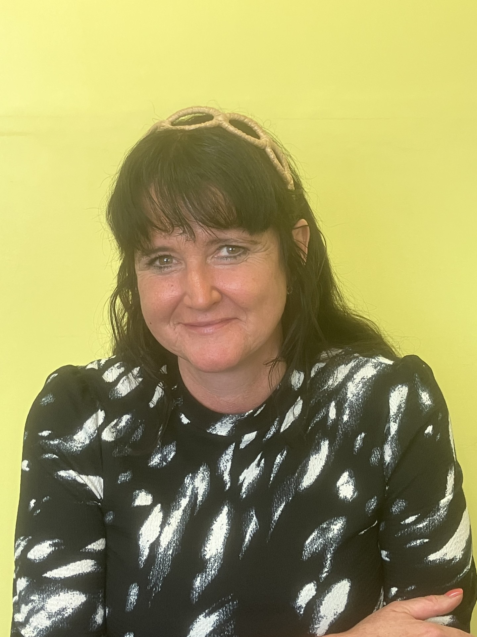
Teaching Staff
Mrs. Ruane
Class Teacher
Mrs. Burke-Harding
Class TA

Slide 4


Slide 5
Daily Routine
Early morning work (8.40am)
Assembly
English
Assembly
Break
Magic 10
Maths
Phonics
Lunch
Other subjects (Blocked Curriculum Time History/Geography/Science/RE/PE)

Slide 6
Autumn Curriculum
        Humanities
        Creation and Covenant, Prophecy and Promise (RE)
        Events beyond living memory (Great Fire of London (History)
        Human and Physical Features in the Local Area (Geography)
        Science
        Introduce Living Things and their Habitats (Science)
        Introduce Animals including Humans (Science)

Slide 7
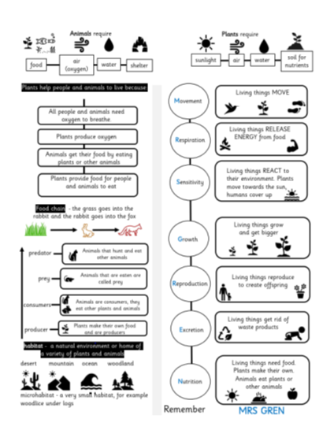
Knowledge Organisers
Used across the curriculum.
Can be downloaded from the school
website.

Slide 8
Homework Expectations
Maths:
Times tables rock stars (5 minutes daily)
Mathletics activities (set weekly)
Spelling:
Spelling focus linked to phonics scheme and will be done as
dictation within class.
Reading:
Every day for 5-20 minutes across range of genres.

Slide 9
Physical Education / Games
PE kit – must be wearing PE kit on Wednesday’s and Thursday’s
Kit should be navy shorts/joggers/leggings/school hoodie and school white t-shirt.
Earrings – please do not wear them on PE days (if they are worn, then children must be able to take them out independently).
Current area of focus:
Football
Fundamentals
Notes:
Talk about earrings
Only have kit on days for PE
what days, still some places in clubs

Slide 10
Uniform
Summer uniform is a pale blue gingham dress and white socks, grey shorts, grey socks and a white school polo shirt.
Winter uniform needs to be worn after Half Term. This is a white shirt, school tie, grey skirt/pinafore dress, navy/grey woollen tights, grey trousers, school jumper or cardigan.
Earrings must be small studs
Shoes must be black formal shoes (not trainers or boots)
Bags must be the school drawstring bags.

Slide 11
Snacks/food
Snacks must be healthy. This is fruit, nothing in packets (e.g. no crisps, chocolate bars, etc)
KS1 have one piece of healthy fruit provided each day.
Water bottles must contain water only. No juice or flavoured water as this impacts on health of children's teeth.
Packed lunches need to contain healthy options, no donuts, big chocolate bars etc.
School dinners are free to all children in KS1 (Reception-Year 2)

Slide 12

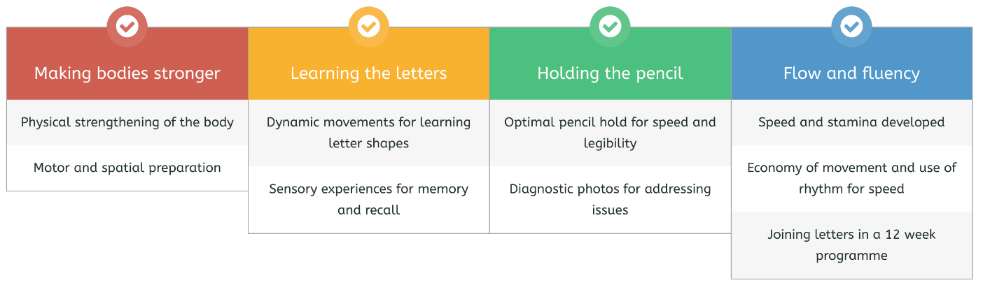
Handwriting Scheme
Daily 20-minute sessions
4 strands of learning in each session to create fluency and automaticity in handwriting.

Slide 13

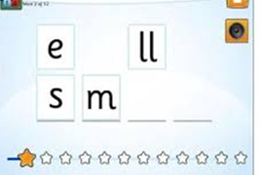
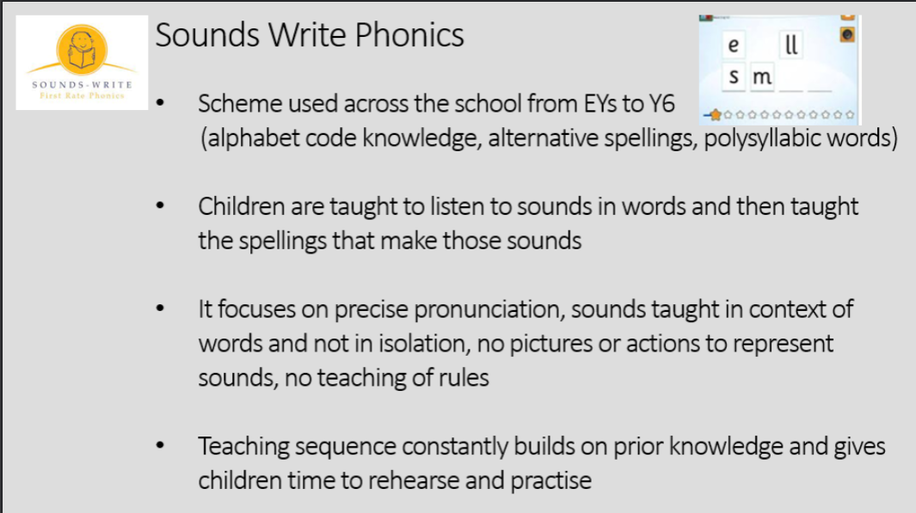
Phonics scheme – Sounds Write

Slide 14
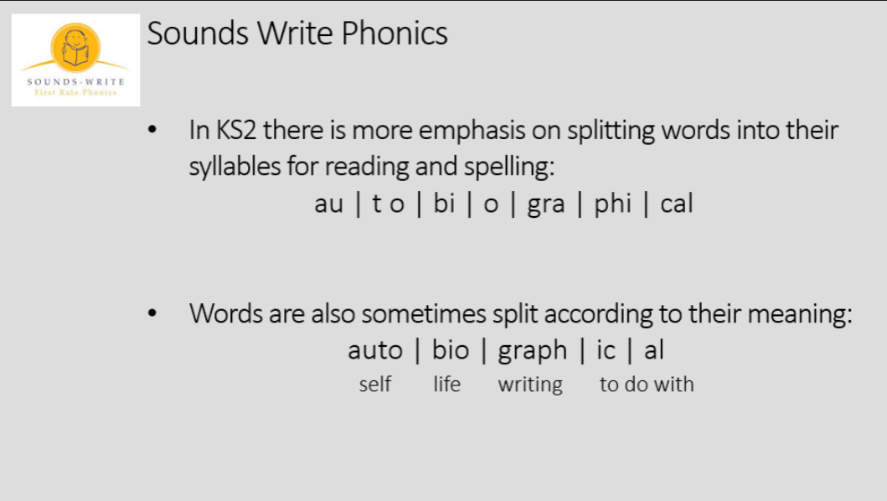
Phonics scheme – Sounds Write

Slide 15
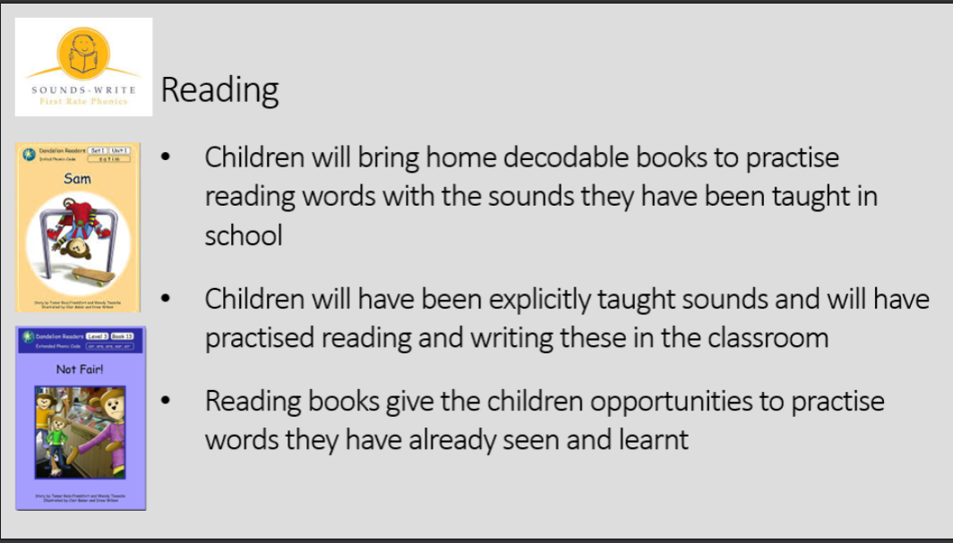
Reading

Slide 16
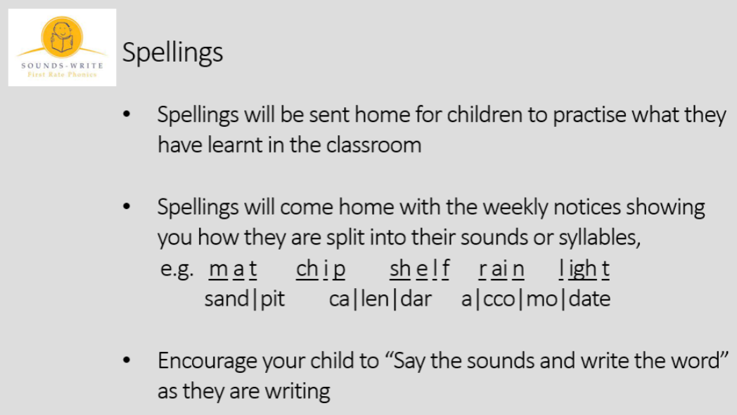
Spellings

Slide 17


How to support your child at home
If your child makes a mistake, repeat the phrases above and/or point with your finger to the error to see if they can fix it themselves
Aim to practise reading and spellings at least four times a week

Slide 18



Online Maths Programmes

Slide 19
TTRS and Numbots
The log on details were sent to you in the form of a letter when your child first started the school.
Your child should complete a minimum of 10 minutes a week on either Numbots (Early Years to Year 3) and / or TTRS (Years 1 to 6)

Slide 20
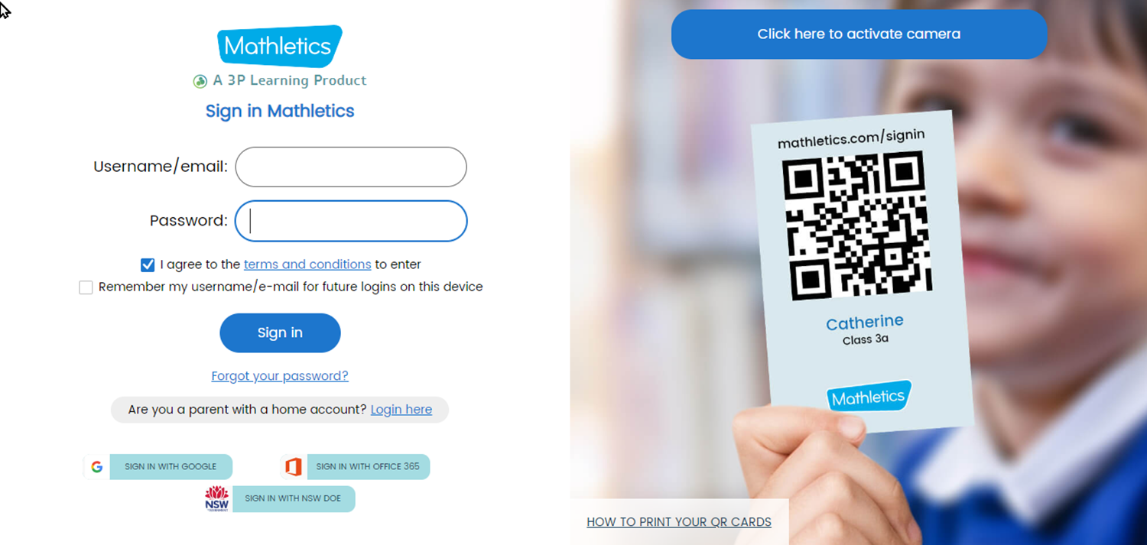
Mathletics
Your child has a passcode slip similar to above. They can log in automatically by scanning the QR code or the username and password on the card.
We ask for a minimum of 10 minutes practise at home each week.
Your child’s teacher will set at least one homework task a week.
Once they complete the homework task, they can choose to do anything else on Mathletics.

Slide 21
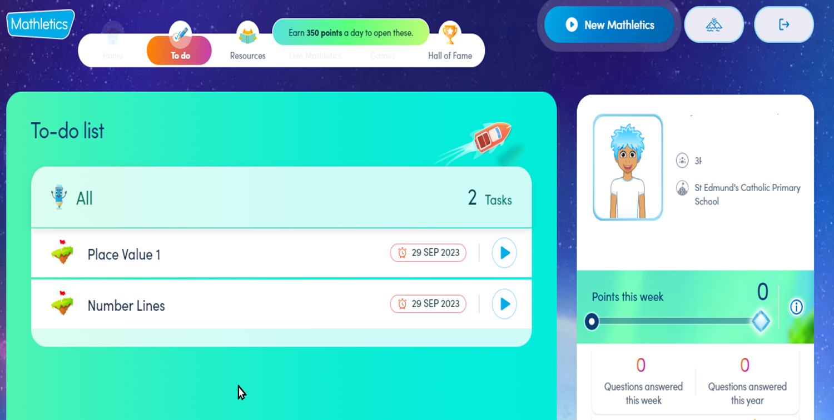
Tasks
Homework tasks will appear on the To-do list when the children first log on

Slide 22
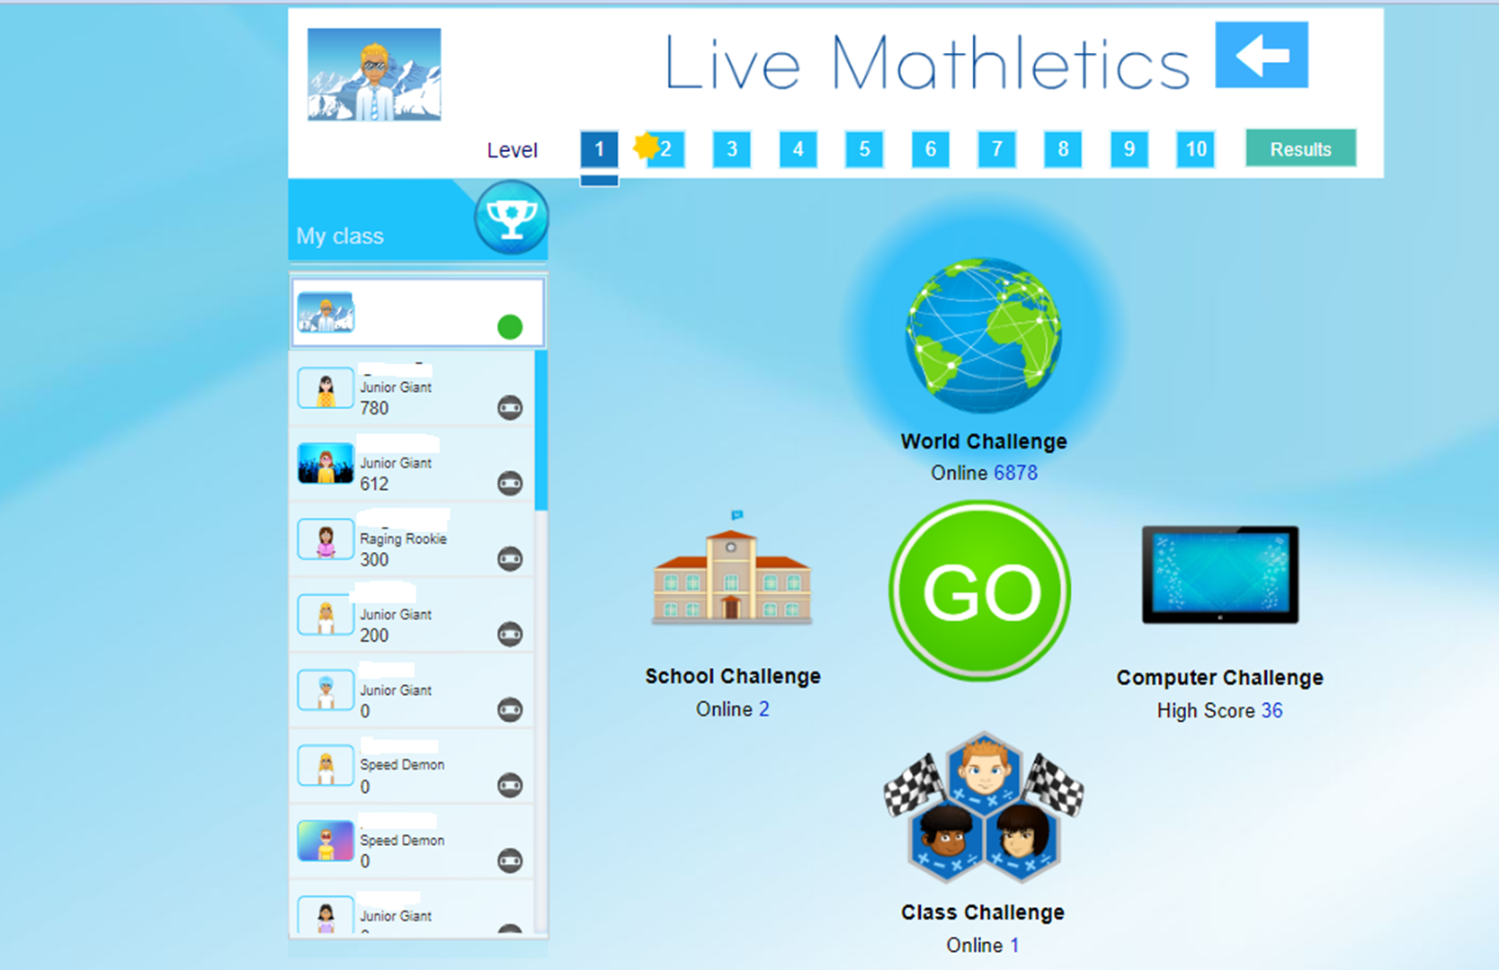


Slide 23
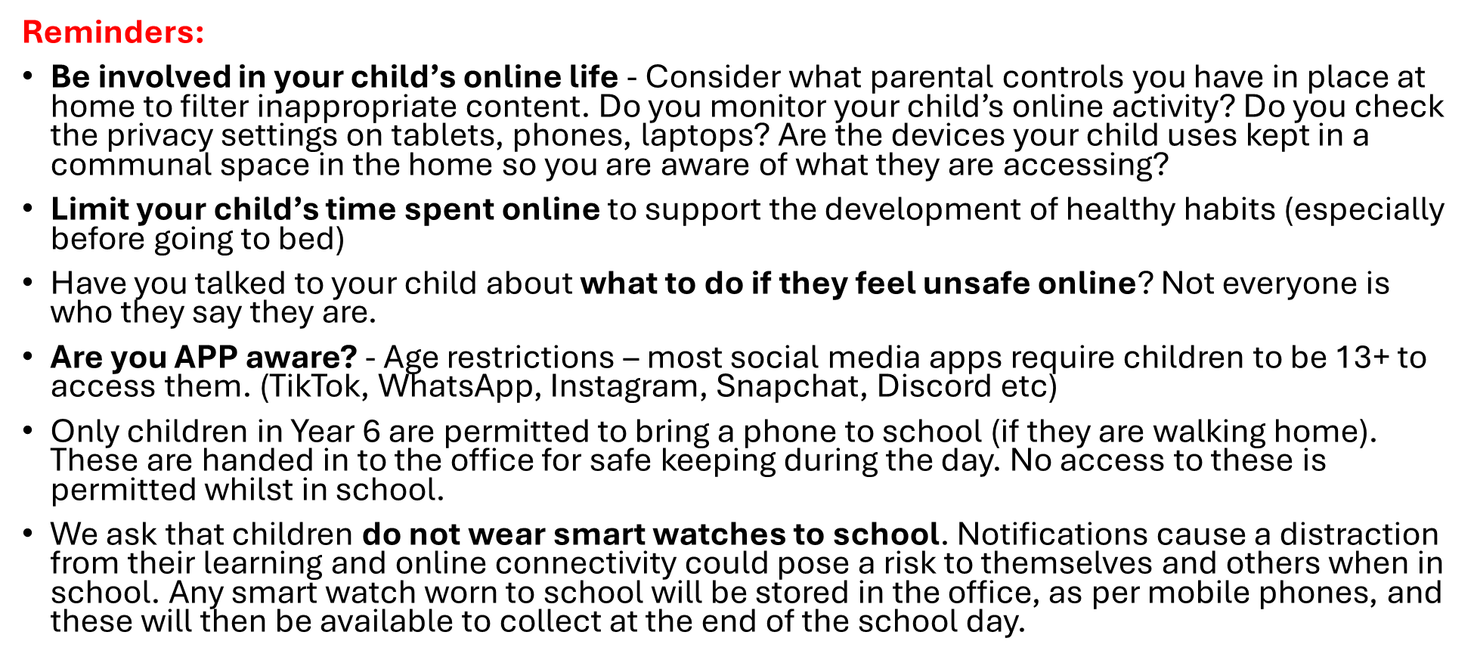
Helping to keep our children safe online
Notes:
Self / peer assessment – how it works

Slide 24
Other Information
Positive Recognition board (Above and Beyond).
Smart walking – Ready, Respectful & Safe
Self and peer assessment (purple pen).
Learning overviews – once a week containing information about the following week and spellings to be learnt.
Half termly overviews outlining what we will be covering in each subject will be found on our webpage.
Notes:
Self / peer assessment – how it works

