Slide 1


Moses Class
Welcome Meeting 2025
Year 1- KS1

Slide 2
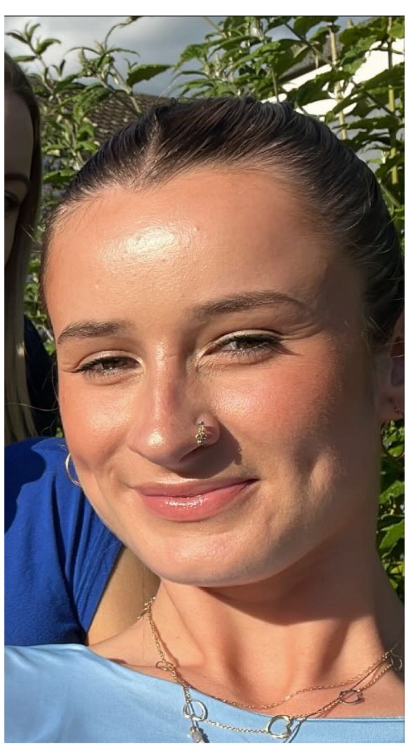
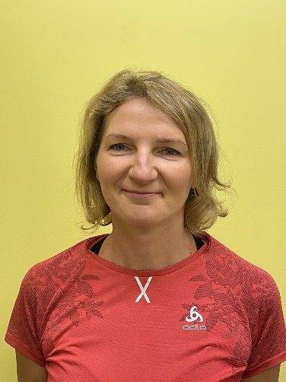
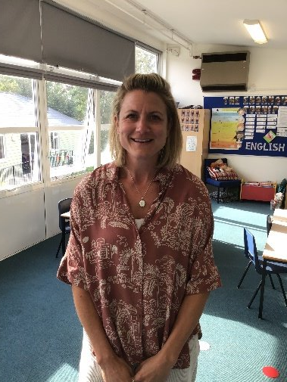
Teaching staff
Miss Jackson
Class teacher
Monday-Friday
Mrs Liffen
Teaching Assistant
Monday-Thursday
Miss Mortimer
PPA cover teacher
Wednesday

Slide 3
Drop off and pick up
Please arrive at school at 8:40 a.m and take your child to the bottom of the steps outside Moses' class. I will be in this area greeting your children.
At 3:15pm, please come to the bench area outside the classroom and I will bring the children out to you in a line to ensure every child finds their adult before leaving my side.

Slide 4
Daily routine
Early morning work (starting at 8:40 am), children will get their whiteboards and do a series of Maths and writing tasks
Assembly
English
Break
Phonics (Sounds Write)
Maths
Lunch
Kinetic letters handwriting
Other subjects- RE, Science, Humanities, Music, Art/DT, Whole class read

Slide 5

Autumn Curriculum
Humanities
Geography – Continents, Oceans, Countries and Capital cities
History- Changes within living memory
Science
Plants and trees
Seasonal changes and weather
Animals including humans
RE
Creation

Slide 6

Your child’s learning
We use Knowledge Notes and Knowledge Organisers to support learning in class. These are used across the curriculum.
Working wall displays are consistently updated to match learning that is taken place in the classroom. These are to aid the children’s understanding and support independent work

Slide 7



Online Maths Programmes

Slide 8
The log on details were sent to you in the form of a letter when your child first started the school.
Your child should complete a minimum of 10 minutes a week on either Numbots (Early Years to Year 3) and / or TTRS (Years 1 to 6)

Slide 9
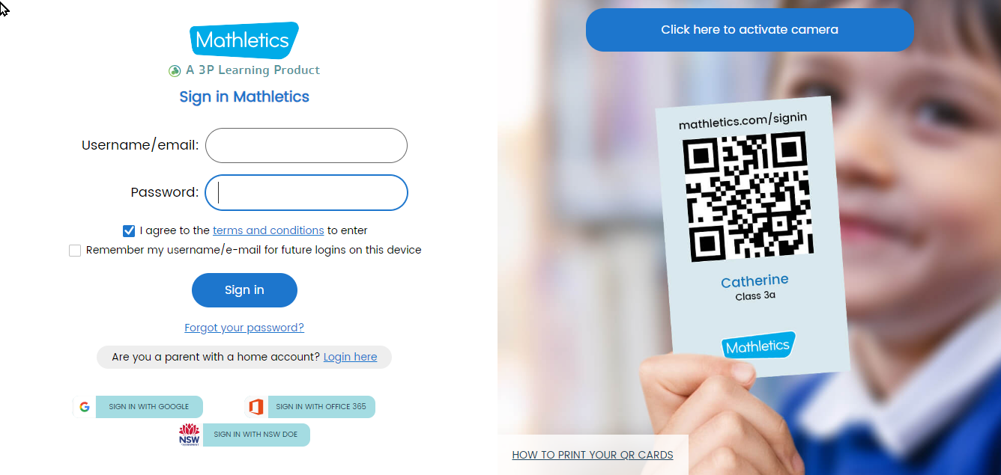
Your child has a passcode slip similar to above. They can log in automatically by scanning the QR code or the user name and password on the card.
We ask for a minimum of 10 minutes practise at home each week.
I will set at least one homework task a week.
Once they complete the homework task, they can choose to do anything else on Mathletics.

Slide 10
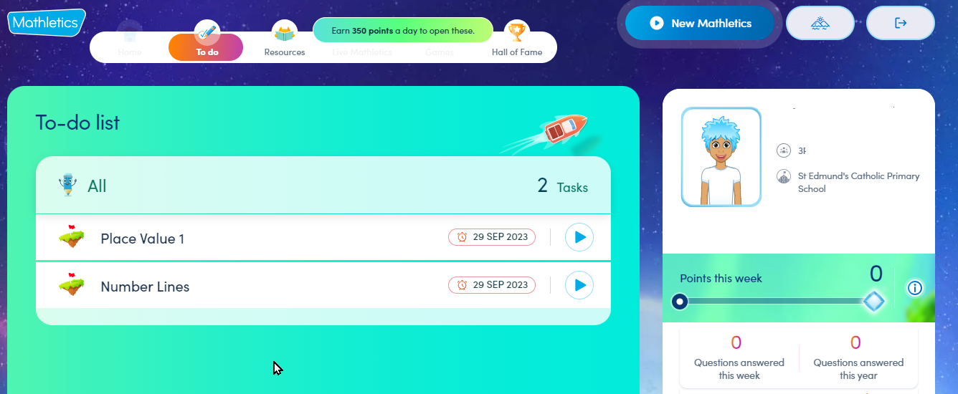
Homework tasks will appear on the To-do list when the children first log on.

Slide 11
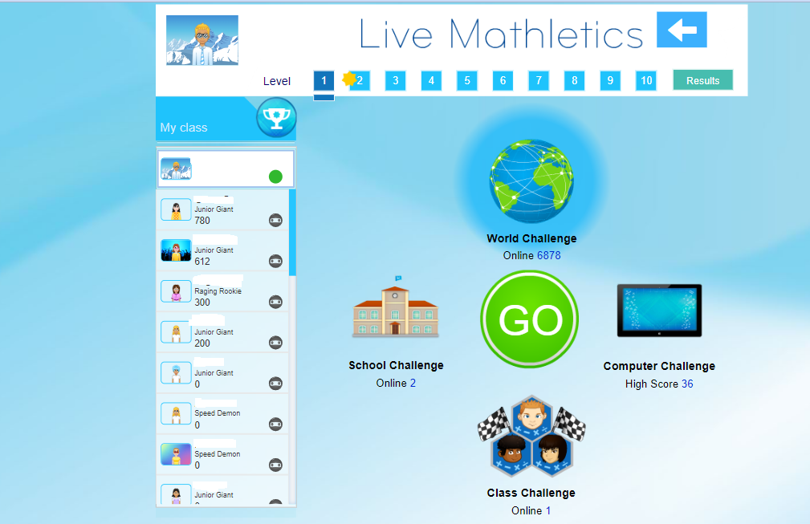
When children have completed their homework, they can then participate in quests, live Mathletics and much more.

Slide 12

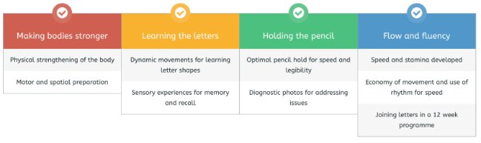
Kinetic letters- Handwriting scheme
Kinetic Letters scheme is used across the federation
Daily 20 minute sessions in Year 1
4 strands of learning in each session to create fluency and automaticity in handwriting

Slide 13

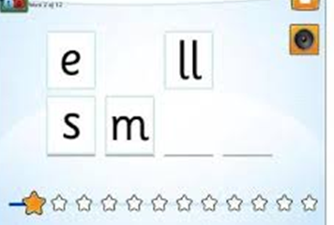
Sounds Write Phonics
Scheme used across the school from EYs to Y6
(alphabet code knowledge, alternative spellings, polysyllabic words)
Children are taught to listen to sounds in words and then taught the spellings that make those sounds
It focuses on precise pronunciation, sounds taught in context of words and not in isolation, no pictures or actions to represent sounds, no teaching of rules
Teaching sequence constantly builds on prior knowledge and gives children time to rehearse and practise

Slide 14


Reading
Children will bring home decodable books to practise reading words with the sounds they have been taught in school
Children will have been explicitly taught sounds and will have practised reading and writing these in the classroom
Reading books give the children opportunities to practise words they have already seen and learnt

Slide 15
Spellings
Spellings will be sent home for children to practise what they have learnt in the classroom
Spellings will come home with the weekly notices showing you how they are split into their sounds or syllables,
e.g. m a t ch i p sh e l f r ai n l igh t
sand|pit ca|len|dar a|cco|mo|date
Encourage your child to “Say the sounds and write the word” as they are writing

Slide 16
How to support your child at home
If your child makes a mistake, repeat the phrases above and/or point with your finger to the error to see if they can fix it themselves
Aim to practise reading and spellings at least four times a week
Say the sounds and read the word.
Say the sounds and write the word.

Slide 17
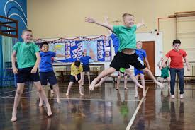
Physical Education
PE kit – must be worn Wednesdays and Fridays
Kit should be navy shorts/joggers/leggings school hoodie and school white t-shirt
Earrings - Please do not wear earrings on PE days (or if the child can remove them themselves). Your child will not be able to participate if they have their earrings in.
Current areas of focus
Dance - different ways of moving
Team games – basic team skills

Slide 18
Uniform
Winter Uniform
Grey trousers (formal tailored – not leggings) OR Grey pleated skirt or tunic
White shirt/blouse.
Navy cardigan OR jumper with school badge.
Navy and red school tie.
Grey/navy tights or grey/white socks.
Low heeled navy or black shoes (no trainers).
Black or Navy raincoat or anorak.
Summer Uniform
White short sleeved shirt OR white short sleeved embroidered polo shirt.
Grey shorts OR Light blue and white gingham dress.
Grey or white socks.
Low heeled black or navy shoes/sandals – not open-toed or open heeled.
Can we make sure that we are not wearing any bangles/bracelets or bows.

Slide 19
Helping to keep our children safe online
Reminders:
Be involved in your child’s online life - Consider what parental controls you have in place at home to filter inappropriate content. Do you monitor your child’s online activity? Do you check the privacy settings on tablets, phones, laptops? Are the devices your child uses kept in a communal space in the home so you are aware of what they are accessing?
Limit your child’s time spent online to support the development of healthy habits (especially before going to bed)
Have you talked to your child about what to do if they feel unsafe online? Not everyone is who they say they are.
Are you APP aware? - Age restrictions – most social media apps require children to be 13+ to access them. (TikTok, WhatsApp, Instagram, Snapchat, Discord etc)
Only children in Year 6 are permitted to bring a phone to school (if they are walking home). These are handed in to the office for safe keeping during the day. No access to these is permitted whilst in school.
We ask that children do not wear smart watches to school. Notifications cause a distraction from their learning and online connectivity could pose a risk to themselves and others when in school. Any smart watch worn to school will be stored in the office, as per mobile phones, and these will then be available to collect at the end of the school day.

Slide 20
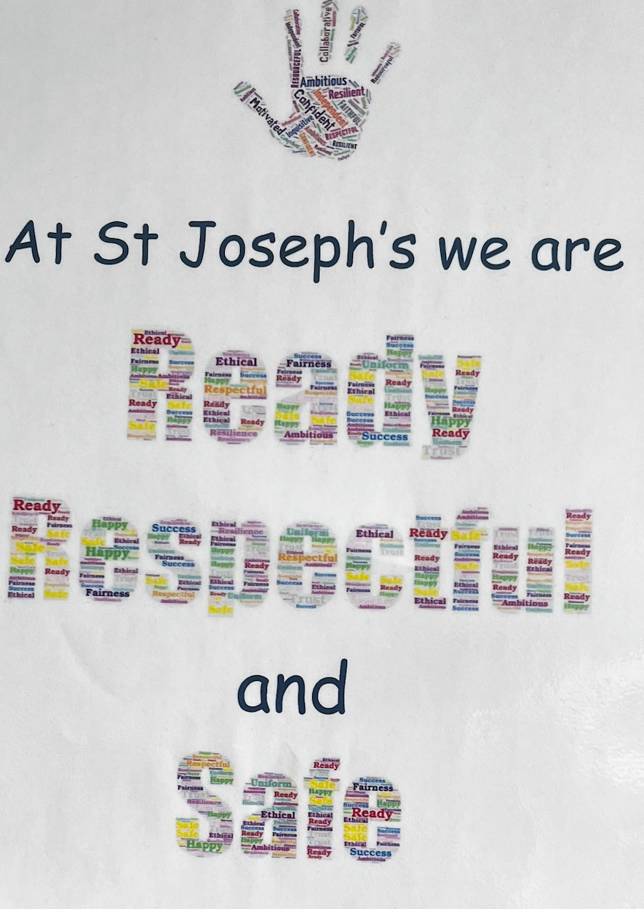
Ready, Respectful and Safe
At St Joseph’s we use the terminology of Ready, Respectful and Safe. We believe that it is vital for children’s learning and well-being to feel safe in school.
Smart walking – we encourage children to walk sensibly around school (penguin position) to ensure everybody is safe – including themselves.

Slide 21
Positive recognition
Positive recognition board – children will be placed on the rockets if they have presented respectful, polite behaviour or gone above and beyond in their learning.
Positive play postcards – used by midday staff to acknowledge children who are playing kindly, showing respect to others and tidying up the play equipment.
Learning characteristics - each week a child from Moses class will be chosen to receive the hand of success if they have demonstrated that specific learning characteristic.
Team points – each child is a member of a house- Constable, Blake, Gainsborough or Turner

Slide 22
Snacks
Snacks must be healthy. This is fruit, vegetables, cheese chunks or crackers. Cheese strings, pepperoni, smoothies and cereal bars are not appropriate
No nuts please
Children are provided with fruit twice a day (snack in morning and afternoon)
Water bottles must contain water only. No juice or flavoured water.
Packed lunches need to contain healthy options (as above)
School dinners are free to all children in KS1 (Reception-Year 2)

Slide 23
Extra-curricular activities and opportunities
For Year 1 there is:
Monday - dance with Maxim sport in the hall (finished 4.20pm - playground gate pick up)
Tuesday - dodgeball with Maxim sports in the hall for year 1 -3 (finishes at 4.20pm - playground gate pick up) & Science club with Dr Rawlins - 12 pupils enrolled - (finished at 4.30pm and pick from the school front office door) .
Wednesday - gymnastics with S4sports in the hall for year 1-6 (finishes at 4.30 pm and pick up at playground gate) & Art club with Mrs Barter and Miss Fitzpatrick - 12 enrolled (finishes at 4.30pm and pick up at school office front door).

Slide 24
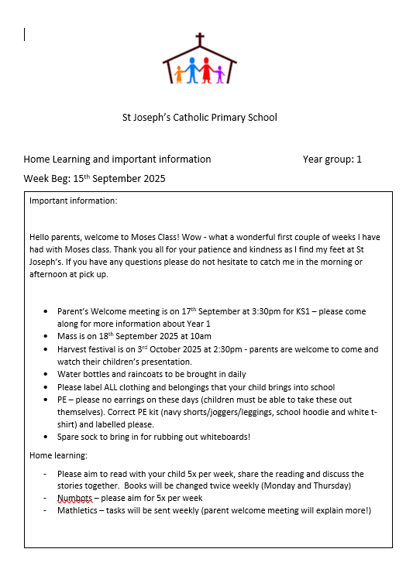
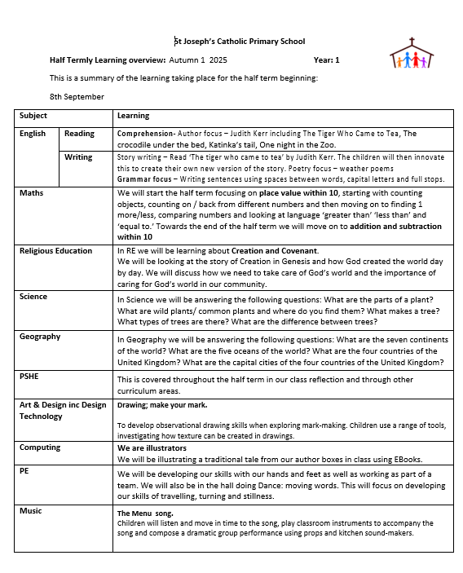
Other information
Learning overviews- once a week containing information about the following week
Half termly overview- outlining what we will be covering in each subject

Slide 25

Thank you for your time ☺
Any questions?

