Slide 1
Abraham Class - Year 3/4
Key stage 2
Curriculum Presentation
2025-2026
‘Encourage and Support’

Slide 2
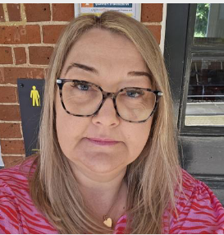
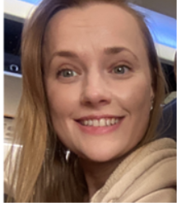
Teaching Staff
LSA support:
Mrs Mumford
Mrs McKenzie
Mrs Soar
Mon, Tues, Thurs
Mrs Williams
Wed, Thurs, Fri

Slide 3
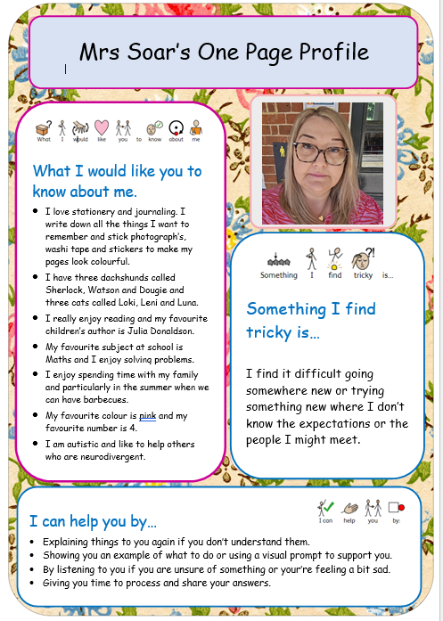
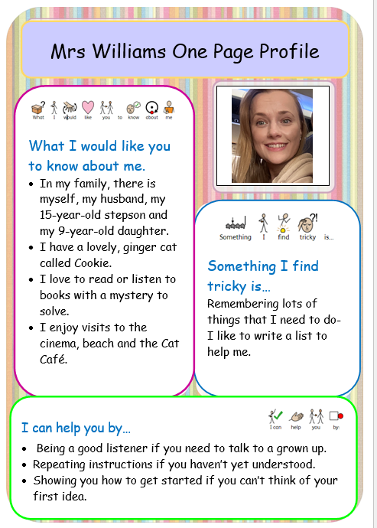

Slide 4
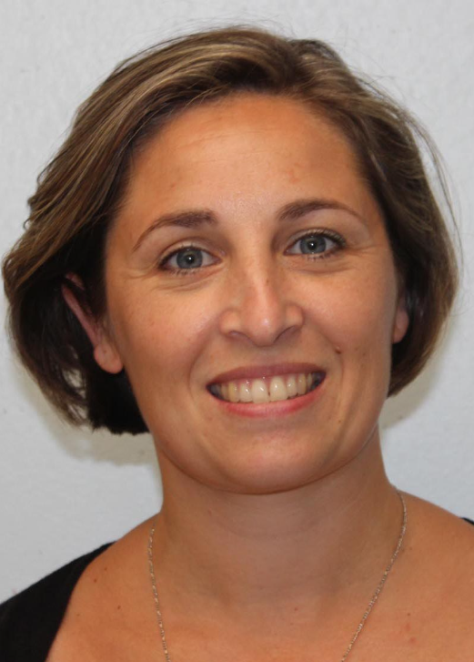
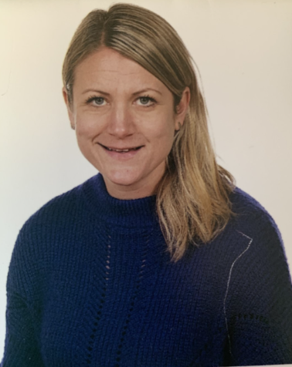
Friday Afternoon Teaching Staff
Mrs Wallace
French teacher
Miss Mortimer
Art and Music

Slide 5
Daily Routine
Early morning work (8.40am)
Assembly
English
Break
Phonics/Reading
Maths
Lunch
Kinetic Letters
Wider curriculum subjects

Slide 6

Ready, Respectful, Safe

Slide 7
Autumn Curriculum
        Humanities
        Rivers and The Water Cycle (Geography)
        British Settlement by Anglo-Saxons and Scots (History)
        Creation and Covenant and Prophecy and Promise (RE)
        Science
        Living Things and Their Habitats
        States of Matter

Slide 8
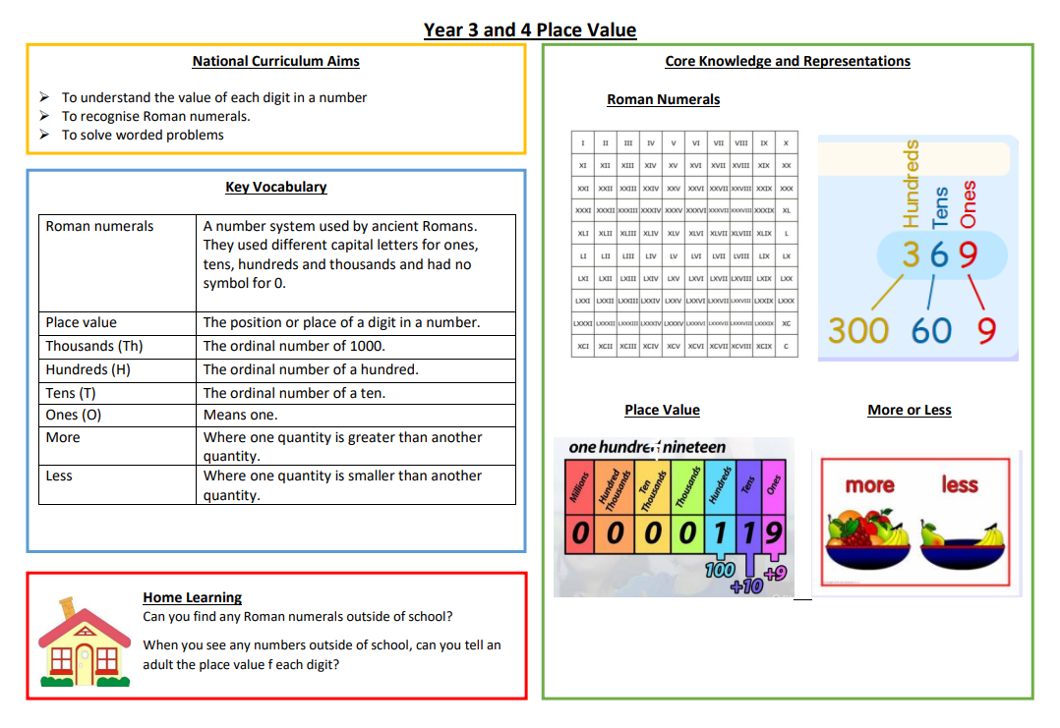
Knowledge Organisers
Used across the curriculum.
Can be downloaded from the school website.
For all topic subjects and Maths.

Slide 9

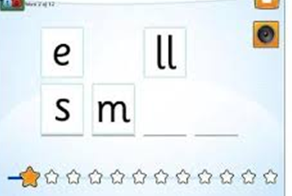
Sounds Write Phonics
Scheme used across the school from EYs to Y6
(alphabet code knowledge, alternative spellings, polysyllabic words)
Children are taught to listen to sounds in words and then taught the spellings that make those sounds
It focuses on precise pronunciation, sounds taught in context of words and not in isolation, no pictures or actions to represent sounds, no teaching of rules
Teaching sequence constantly builds on prior knowledge and gives children time to rehearse and practise
Notes:
Teach children starting with sounds – children listen for sounds in words and then learn the spellings that represent them.
EY – alphabet code knowledge
Y1/2/3/4 – alternative spellings for sounds and polysyllabic words
Y5/6 – explicit teaching of spelling and analysing words
Explain precise pronunciation and how the chn are explicitly error corrected to ensure that this is the case. Be mindful particularly of sounds /q/ /w/ /y/

Slide 10
In KS2 there is more emphasis on splitting words into their syllables for reading and spelling:
au | t o | bi | o | gra | phi | cal
Words are also sometimes split according to their meaning:
auto | bio | graph | ic | al
self life writing to do with
Notes:
A SW catch phrase used in school is “say the sounds and write the word”
Y2-6 also mention polysyllabic words – “say the sounds, write the syllable”
Saying the sounds as the child writes the word is really important so encourage your child to say the sounds as they write. Writing them also helps with muscle memory and is a reflection of what we are doing in the classroom.

Slide 11
Spellings
Spellings will be sent home for children to practise what they have learnt in the classroom.
Spellings will come home with the weekly notices showing you how they are split into their sounds or syllables,
e.g. m a t ch i p sh e l f r ai n l igh t
sand|pit ca|len|dar a|cco|mmo|date
Encourage your child to “Say the sounds and write the word” as they are writing.
Notes:
Teach children starting with sounds – children listen for sounds in words and then learn the spellings that represent them.
EY – alphabet code knowledge
Y1/2/3/4 – alternative spellings for sounds and polysyllabic words
Y5/6 – explicit teaching of spelling and analysing words
Explain precise pronunciation and how the chn are explicitly error corrected to ensure that this is the case. Be mindful particularly of sounds /q/ /w/ /y/

Slide 12
How to support your child at home
If your child makes a mistake, repeat the phrases above and/or point with your finger to the error to see if they can fix it themselves.
In KS2, the children can move on to saying the syllables and reading/spelling the word.
Aim to practise reading and spellings at least four times a week.
Say the sounds and read the word.
Say the sounds and write the word.
Notes:
We use these phrases in school so using these at home would help the children hear the same message.
Regular practise is important so aim for a minimum of four times a week for reading and spelling.

Slide 13

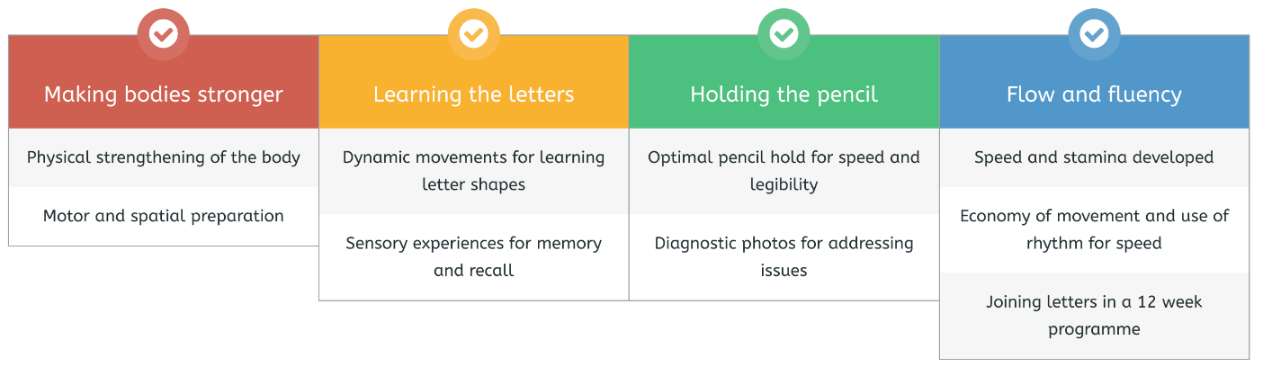
Handwriting Scheme
Daily 20-minute sessions.
4 strands of learning in each session to create fluency and automaticity in handwriting.

Slide 14


The children login details have been sent home with them.
Mathletics can also be accessed using the QR code or by typing it in.
We are aiming for 10-15 minutes of TTRS a day.
Mathletics should be around 10-15 minutes a week.
Some tasks are longer and trickier than others.

Slide 15
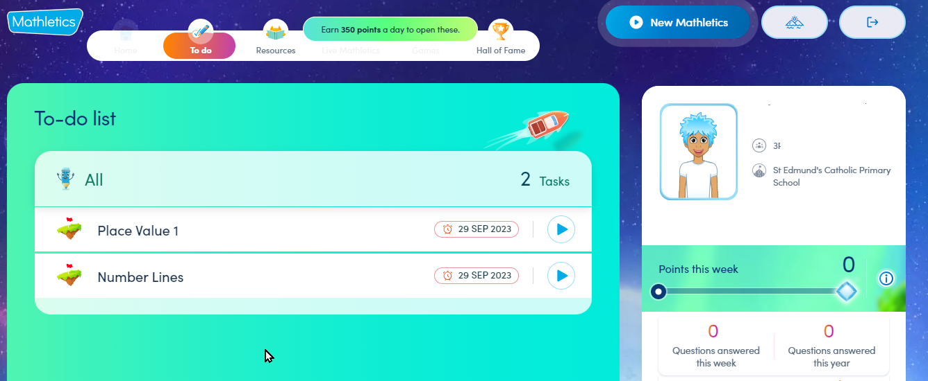
Homework tasks will appear on the To-do list when the children first log on.

Slide 16
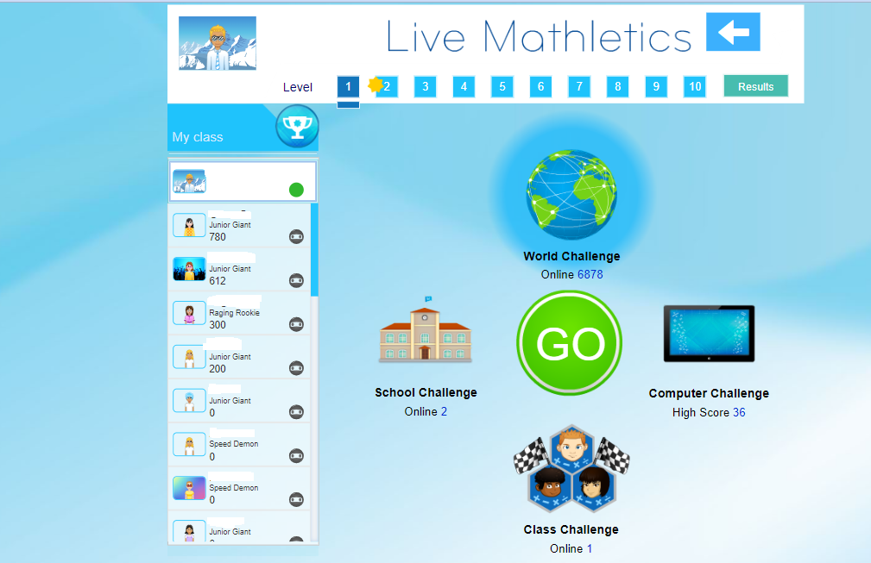
When children have completed their homework, they can then participate in quests, Live Mathletics and much more.

Slide 17
Homework Expectations
Maths:
Times tables rock stars (5 minutes daily)
Mathletics activities (tasks set weekly)
Spelling:
Spellings are set weekly and are on the weekly learning
intentions
Reading:
Aim for 5 times a week

Slide 18
Uniform
After October half term the children should be attending school in their winter uniform. You can visit the Aubyn Davies website to order online at www.aubyndavies.co.uk. Or you can visit the shop at 81 St Johns Street, Bury St Edmunds, IP33 1SQ.
Winter Uniform
Grey trousers (formal tailored – not leggings) OR grey pleated skirt or grey tunic
White shirt/blouse
Royal blue cardigan or jumper with school badge
Royal blue and red tie
Black or navy blue socks or tights, or grey/white socks
Low heeled navy or black shoes (no trainers)
Black or Navy raincoat or anorak

Slide 19
Other expectations:
Necklaces and bracelets or bangles should NOT be worn
Earrings – small studs only please. No hoops or drops. All earrings to be removed for PE days
Please…no stationery, toys, mascots, hairbrushes etc

Slide 20
Physical Education / Games
PE kit – must have PE kit on a Tuesday and Thursday
Earrings – please do not wear them on PE days (if they are worn, then children must be able to take them out independently).
Current area of focus:
Tag Rugby
Sports Hall Gymnastics
Notes:
Talk about earrings
Only have kit on days for PE
what days, still some places in clubs

Slide 21
Extra Curricular
We encourage children to take part in the wider life of the school:
Choir
Sports clubs – football, basketball, cross-country
Art Club
Science Club
Notes:
Talk about earrings
Only have kit on days for PE
what days, still some places in clubs

Slide 22
Helping to keep our children safe online
Reminders:
Be involved in your child’s online life - Consider what parental controls you have in place at home to filter inappropriate content. Do you monitor your child’s online activity? Do you check the privacy settings on tablets, phones, laptops? Are the devices your child uses kept in a communal space in the home so you are aware of what they are accessing?
Limit your child’s time spent online to support the development of healthy habits (especially before going to bed)
Have you talked to your child about what to do if they feel unsafe online? Not everyone is who they say they are.
Are you APP aware? - Age restrictions – most social media apps require children to be 13+ to access them. (TikTok, WhatsApp, Instagram, Snapchat, Discord etc)
Only children in Year 6 are permitted to bring a phone to school (if they are walking home). These are handed in to the office for safe keeping during the day. No access to these is permitted whilst in school.
We ask that children do not wear smart watches to school. Notifications cause a distraction from their learning and online connectivity could pose a risk to themselves and others when in school. Any smart watch worn to school will be stored in the office, as per mobile phones, and these will then be available to collect at the end of the school day.

Slide 23
Other Information
Snacks-healthy please. Fruit, vegetables, cheese or a healthy yoghurt- children no longer get free fruit from school in KS2!
Our learning characteristic
Half termly overview – containing information regarding the half term ahead
Learning Intentions – once a week containing important messages and weekly spellings
Damaged reading books-please send in £5 to the office so we can replace it
School bags-drawstring bags

Slide 24
Thank you for coming!
Any questions please come and find us, or speak to Mrs Harris, Mrs Mulligan or
Mrs Kemble.

