Slide 1
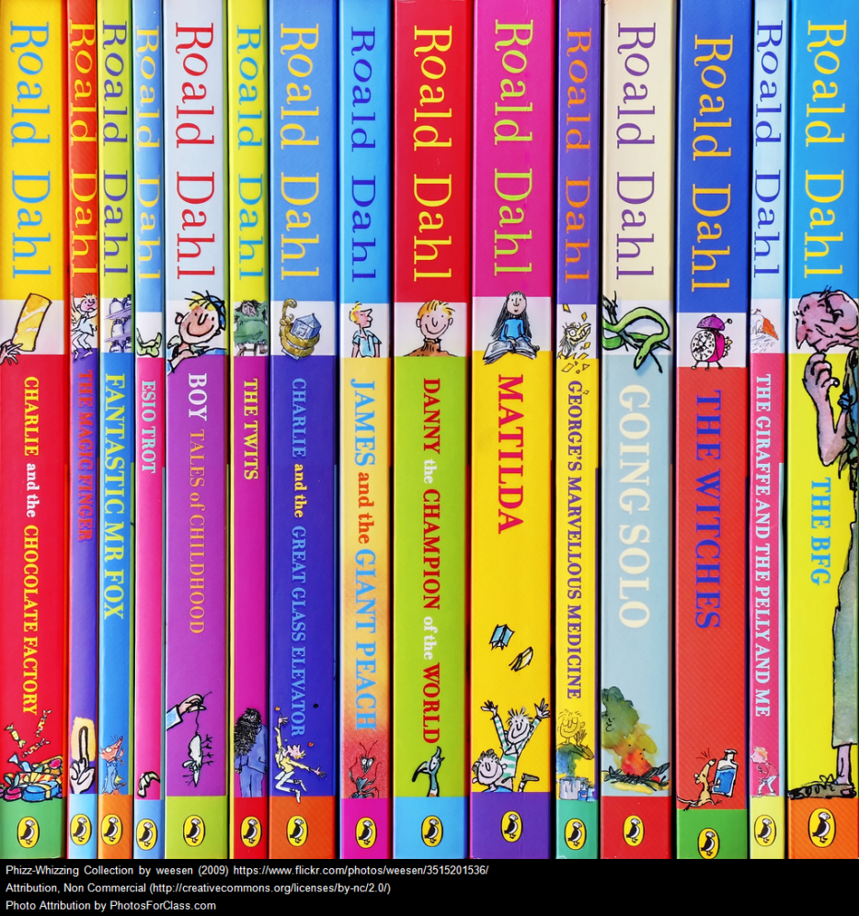
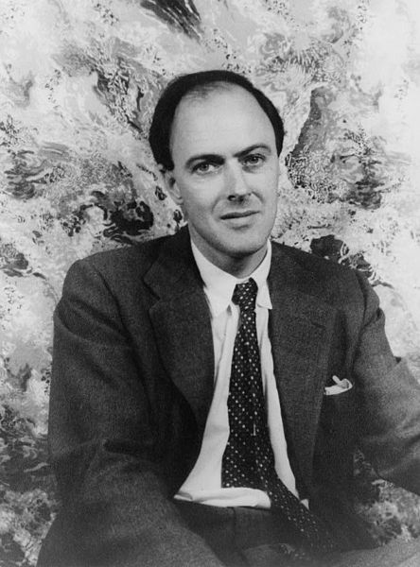
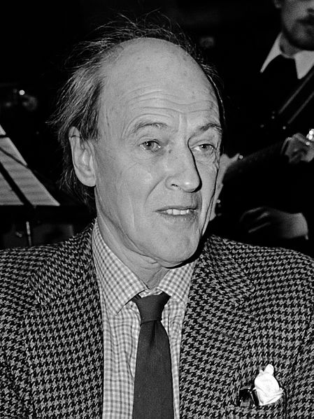
L.O. To read and discuss a narrative poem
You might recognise this man.
Today we will be looking at Roald Dahl’s poetry.
And I am sure that you will know some of his books.

Slide 2
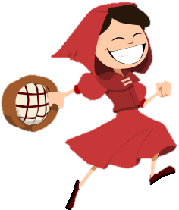
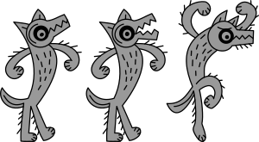
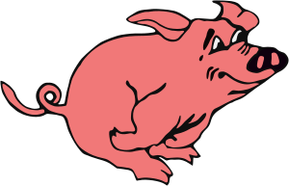
L.O. To read and discuss a narrative poem
Revolting Rhymes
The Revolting Rhymes are all based on famous traditional stories, but with a difference. Be warned: they do not always have the usual happy ending!
Roald Dahl loved to add twists and turns in his stories.
He also loved to add grizzly and gruesome parts to his poems.
Little Red Riding Hood video
Three Little Pigs video
Cinderella video
Snow White video
Jack and the Beanstalk video
Goldilocks video
http://www.funny-poems.biz/roald_dahl/Roald-Dahl-poems-biography-books-funny-poetry-online-collection.html

Slide 3
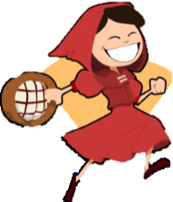
L.O. To read and discuss a narrative poem
Revolting Rhymes
Which parts are the same as in the original traditional story?
Which is your favourite Revolting Rhyme?
What do you like about it?
Which parts are different to the original story?
Do you think that your favourite Revolting Rhyme has a happy ending? Why?

Slide 4
Task 1
L.O. To read and discuss a narrative poem
Revolting Rhymes
Choose your favourite Revolting Rhyme and read through it carefully, then answer the following questions:
Which characters are in the poem?
Who do you think is the hero or heroine of the poem?
Which things are the same in the poem as in the original story?
Which things has Roald Dahl changed?
Do you think the poem has a happy ending? Explain why.
What do you think makes this a ‘Revolting’ Rhyme?
Write down the five pairs of rhyming couplets that you like best in the poem.
How many syllables are in each line of each rhyming couplet?
Challenge 1
Can you write an alternative verse to fit into your Revolting Rhyme? Remember the rhyme and syllable patterns!
Challenge 2
Write a recount of the events in the Revolting Rhyme from one of the character’s point of view.

Slide 5
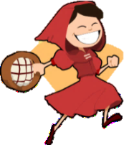
Task 2
L.O. To read and discuss a narrative poem
Revolting Rhymes
Have fun with making some similes for a character in one of the Revolting Rhymes.
Nerves like...
As brave as...
A mind like...
As ruthless as...
Fights like...
Challenge!
Write an acrostic poem from the words Revolting Rhymes.
As cunning as...
Little Red Riding Hood

Slide 6
Task 3
L.O. To read and discuss a narrative poem
Revolting Rhymes
Alliteration is often used in poetry, but also in newspaper headlines.
Try writing some alliterative newspaper headlines, based on Revolting Rhymes.
Character:
Wolf
Adjectives:
Wily
Weird
Wise
Wicked
Wonderful
Wimpy
Wild
Tips!
Start by choosing a character.
Now think of words that begin with the same sound as your character – adjectives, verbs and adverbs are all useful!
Now see if you can link them together into an interesting newspaper headline.
Adverbs:
Weirdly
Wildly
Woefully
Wickedly
Worryingly
Verbs:
Worry Wish Watch Wallop
Wait Warn

Slide 7
Task 3
L.O. To read and discuss a narrative poem
Revolting Rhymes
Wicked wolf gobbles gullible granny.
Character:
Wolf
Adjectives:
Wily
Weird
Wise
Wicked
Wonderful
Wimpy
Wild
Wily wolf waits to greedily grab grey old granny.
Adverbs:
Weirdly
Wildly
Woefully
Wickedly
Worryingly
Rampant Red remarkably whips woeful wolf.
Verbs:
Worry Wish Watch Wallop
Wait Warn
Challenge!
Write the newspaper article that goes with one of your alliterative headlines.

Slide 8

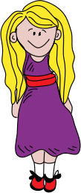
Task 4
L.O. To read and discuss a narrative poem
Revolting Rhymes
Wanted!
Now design a ‘Wanted’ poster for a Revolting Rhymes character of your choice.
This young criminal goes by the name of Goldilocks. She is a housebreaker and burglar, with no care for property or privacy. In her most recent crime, she broke into Mr and Mrs Bear’s house and stole all of their delicious porridge, before destroying several valuable possessions.
Personal details
Age: 7
Hair colour: Blonde
Height: 113cm
Build: Heavy enough to shatter chairs
Challenge!
Design a front cover and blurb for a biography about your character.
The criminal was last seen roaming around the forest, searching for food to steal from innocent families. She is not thought to be dangerous, just incredibly sneaky and annoying.
Goldilocks
Reward
10 gold coins and a huge bowl of porridge for capturing this thief...dead or alive!

Slide 9

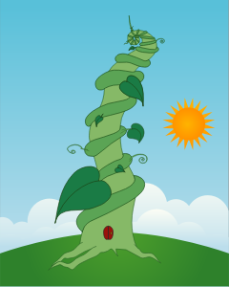
Task 5
L.O. To read and discuss a narrative poem
Revolting Rhymes
Write an interview between one character from Revolting Rhymes and a television chat show host.
Interviewer: Why did you sell your family’s cow for a single bean?
Jack: Well, I didn’t really like Daisy that much and it seemed like the right thing to do at the time. Besides, this is Fairy Tale Land...something magical can happen at any moment!
Interviewer: And how did you feel when you first saw the beanstalk?
Jack: Very pleased to be proved right.
Interviewer: In what way?
Jack: Well, my silly old mum thought I was a fool...but even she could see that there was something special about that bean!
Challenge!
Design an advertising poster to persuade people to buy Revolting Rhymes.

