Slide 1
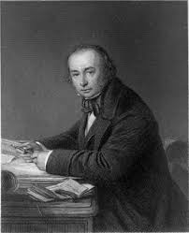
Isambard kingdom Brunel
Lesson 1
Which century do you think he lived in?
What job do you think he did?

Slide 2
A genius of the Victorian age… https://gridclub.com/activities/brunels-britain
Who do you admire? A footballer? A Pop star?
150 years ago it was a man called Isambard Kingdom Brunel who was amazing the world with his skill and imagination. Brunel was an inventor, a designer and engineer who built not just bridges or tunnels or ships but all three! In Victorian England he created structures and vehicles which to others seemed impossible.
There's a good chance that you have travelled through a tunnel or crossed a bridge which Brunel built. Some people have called him the Greatest Briton ever. See what you think…

Slide 3
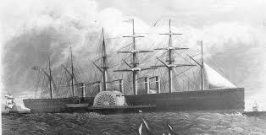
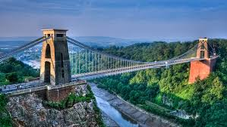
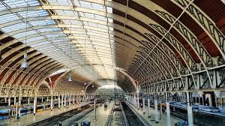
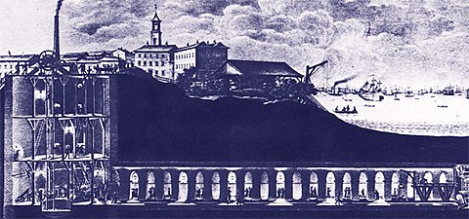
Some of his work.
SS Great Eastern
Clifton bridge
Paddington station
Thames Tunnel

Slide 4
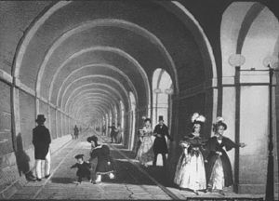
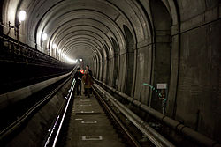
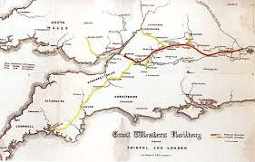
Brunel’s life.
1806: born in Portsmouth
1808: family moves to London
1820: Brunel is sent to France to study maths and engineering
1822: Brunel joins his father’s engineer office in London.
1825: Brunel’s first big (joint) project begins: the Thames tunnel.
1831: Brunel wins a design competition for a bridge across the Avon river in Clifton, Bristol.
1833: Brunel is appointed chief engineer of the Great Western Railway- linking London to Bristol
1836: wedding to Mary Horsley
Thames tunnel, then and now…
Great Western Railway

Slide 5
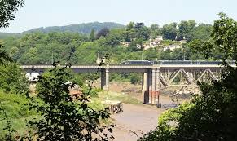
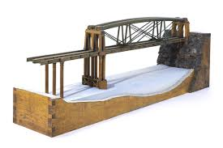
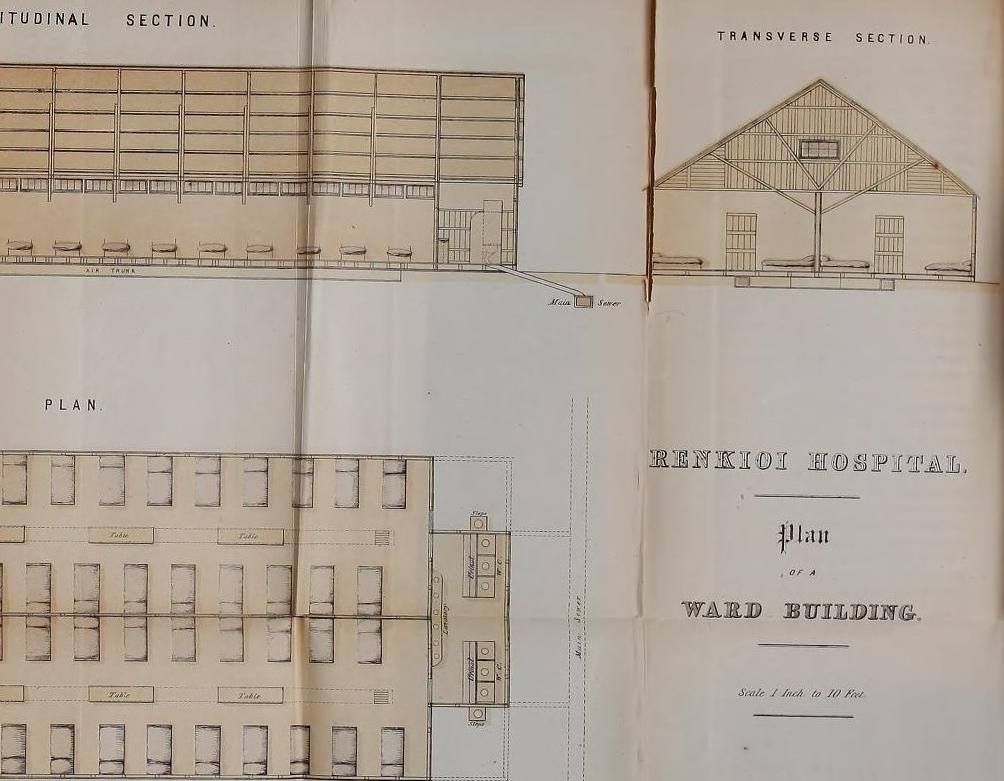
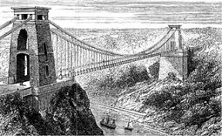
1838: SS Great Western ship travels from Liverpool to New York in 13 days
1852: Chepstow bridge opens
1854: Paddington station opens
1855: Brunel designs the Renkioi hospital, a temporary hospital that was sent to the Crimea for wounded soldiers during the Crimean War- after Florence Nightingale suggested drastic improvements!
1859: Brunel dies
1864: the Clifton suspension bridge is finished
Chepstow tubular suspension bridge
Renkioi temporary hospital plans

Slide 6
Brunels life- online class activity.
Put the 6 pictures of the comic strip in order.
(Brunel’s Britain -> activities -> Brunel’s life) https://gridclub.com/activities/brunels-britain

Slide 7
Activity.
Put these events in chronological order. Match each event to a date. Write each date and event in your books.
1806
1820
1822
1825
1831
1837
1838
1843
1853
1854
1855
1859
1864
Brunel wins a bridge design competition for the river Avon
SS Great Western ship travels from Liverpool to New York in 13 days
Victoria becomes queen
Renkioi hospital is designed.
Thames Tunnel opens
Death of Brunel
Brunel is sent to France to study maths and engineering
Brunel joins his father’s engineering office in London
Birth of Brunel
Clifton bridge is completed.
The Crimean War starts
Paddington station opens
Work begins on Thames’ Tunnel

Slide 8
Date and event matching activity.
THE ANSWERS!!
1806
1820
1822
1825
1831
1837
1838
1843
1853
1854
1855
1859
1864
Birth of Brunel
Brunel is sent to France to study maths and engineering
Brunel joins his father’s engineering office in London
Work begins on Thames’ Tunnel
Brunel wins a bridge design competition for the river Avon
Victoria becomes queen
SS Great Western ship travels from Liverpool to New York in 13 days
Thames Tunnel opens
The Crimean War starts
Paddington station opens
Renkioi hospital is designed.
Death of Brunel
Clifton bridge is completed.

Slide 9
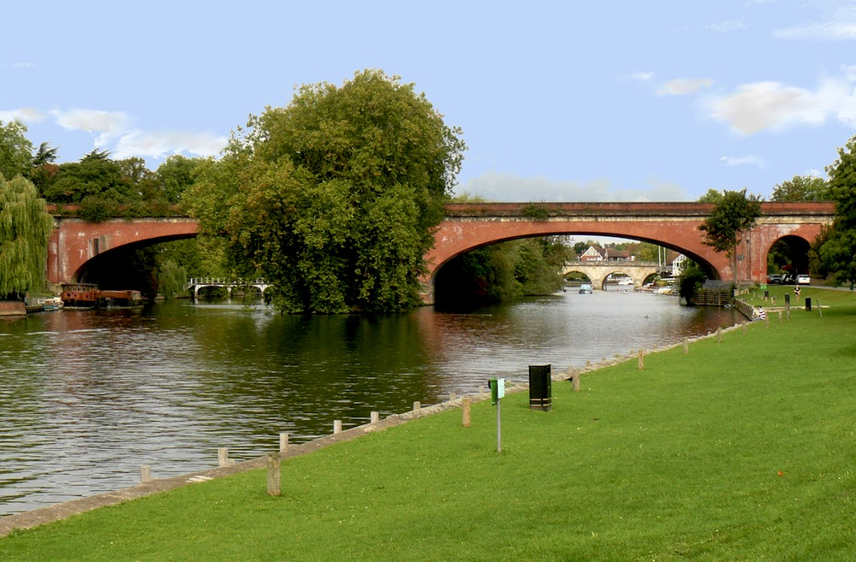
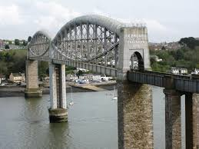
BRUNEL’S BRIDGES (incl. suspension bridge investigation).
LESSON 2
What are bridges for?
What would have been Brunel’s considerations?
Do they all work in the same way?

Slide 10
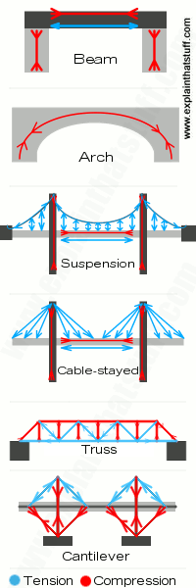
What is a bridge for? A bridge is a structure to cross an open space or gap. Bridges are mostly useful for crossing rivers, valleys, or roads by vehicles but people have also used bridges for a long time for walking.
Do bridges all work the same way?
There are four basic types of bridges: Beam bridges, Arch bridges, Cantilever bridges and Suspension bridges. For a bridge to work, the tension and compression forces have to be counterbalanced.
What would have been Brunel’s considerations?
Safety- bear weight well; inclination (eg flat for railway bridge); length of space to cover; height of arches- allowing enough space for ships to pass under; aesthetics…

Slide 11
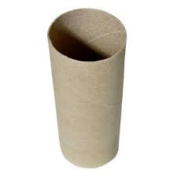
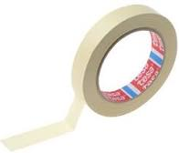
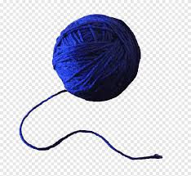
Activity. Science investigation.
Step 1. You are given a piece of string, 2 toilet rolls and some masking tape. Can you build a bridge out of them?
Test your bridge with a light object. Can it bear its weight?
Reflect. Remembering what we have learnt on bridge design, how could we improve, using the same materials?
(Watch Brunel’s Britain factfile on bridges:
https://gridclub.com/activities/brunels-britain )

Slide 12
Part 2.
You are now given a longer piece of string plus the same materials. Can you try and build a suspension bridge?
Now test your bridge as before. Can your bridge bear the weight? Why/Why not? What has changed?

Slide 13
Lesson 3. Paper bridge building experiment
WHAT MAKES A BRIDGE STRONG?
https://www.youtube.com/watch?v=oVOnRPefcno

Slide 14

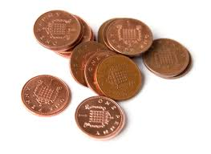

PAPER BRIDGE EXPERIMENT. Stem activity https://www.youtube.com/watch?v=CqYGVW2Eu6Y
Follow the experiment and replicate with the materials provided: paper sheet, coins, books.
What changes over the course of the experiment?

Slide 15
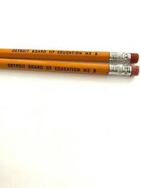

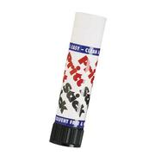
PAPER BRIDGE EXPERIMENT. Build your own. https://www.youtube.com/watch?v=YM0g1vCEMpc
Follow the experiment and replicate with the materials provided: 3 paper sheets, 2 pencils, books, glue, scissors.
Test your bridge. How many coins can it bear the weight of? Why do you think that is?
Reflect - Were you successful in replicating the strong bridge on the video?

