Slide 1
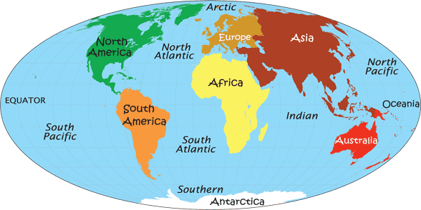
The geography song

Slide 2

The geography song
Did you know that the land on our planet
Is divided into parts?
There are seven continents
Let’s learn them off by heart
Oh, divided into parts
Oh, let’s learn them off by heart!
Come on, let’s go
Tell me what you know
Explore the planet with me
We call it geography.
Let’s go to Asia, Africa, North and South America
Antarctica, Europe and Australia (x2)

Slide 3
Did you know the water on our planet
Is divided into parts?
There are five blue sparkling oceans;
Let's learn them off by heart.
Oh, divided into parts,
Oh, let's learn them off by heart.
Chorus
The Southern, Atlantic, Pacific and Indian,
The Arctic Ocean is a little cold. (x4)
Let's go to Asia, Africa, North and South America,
Antarctica, Europe and Australia. (x4)

Slide 4
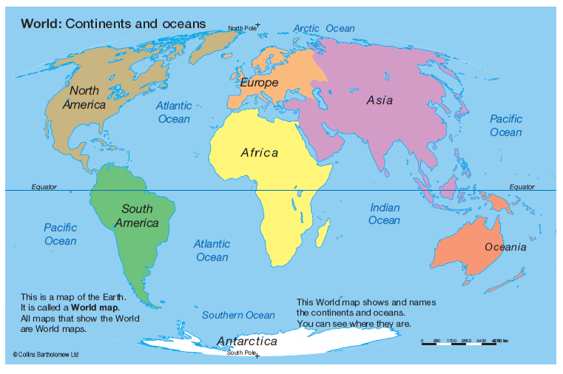


Listen to the song and point to the continents and oceans on the map.
Can you put Moana on the continents and Nemo in the oceans?

