Slide 1
TODAY’S LESSON: simple Machines
Vocabulary:
simple machine
pulley
lever
ramp

Slide 2
SIMPLE MACHINES
WHAT IS A SIMPLE MACHINE ?
A simple machine is a tool
that can make it easier to
move things.

Slide 3
SIMPLE MACHINES
Let’s learn about 3 types of simple machines:
pulley
lever
ramp

Slide 4
P
U
L
L
E
Y
Types of Simple Machines
1
WHAT IS A PULLEY ?
A pulley is a rope that
moves over a wheel.

Slide 5
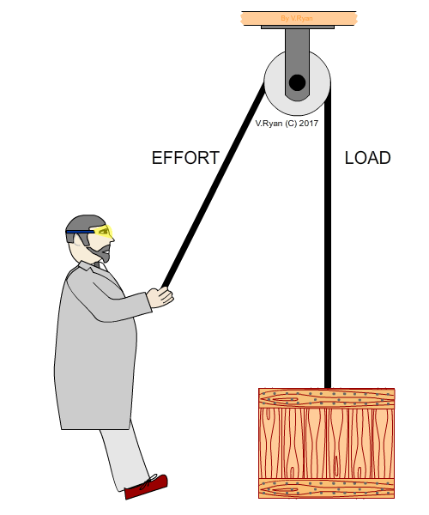
P
U
L
L
E
Y
Types of Simple Machines
1

Slide 6
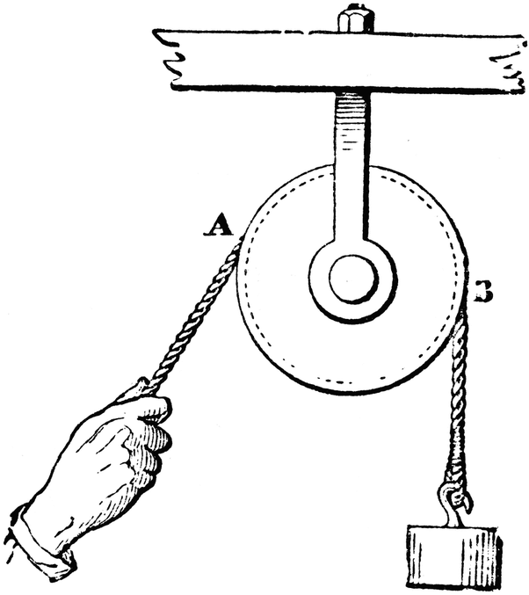
P
U
L
L
E
Y
Types of Simple Machines
1
wheel
rope
load

Slide 7
L
E
V
E
R
Types of Simple Machines
2
WHAT IS A LEVER ?
A lever is a bar that
balances on a fixed point.
It moves like a seesaw.

Slide 8
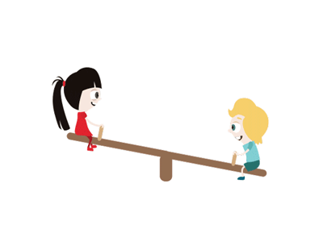
L
E
V
E
R
Types of Simple Machines
2

Slide 9
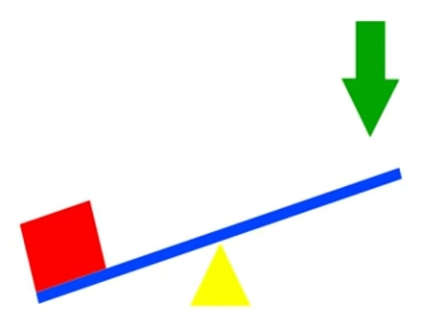
L
E
V
E
R
Types of Simple Machines
2
bar
fixed point

Slide 10


L
E
V
E
R
Types of Simple Machines
2
fixed point
bar
oar

Slide 11
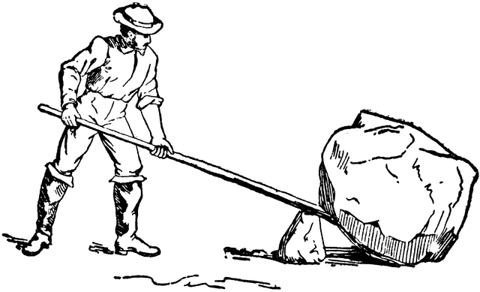
L
E
V
E
R
Types of Simple Machines
2
bar
fixed point

Slide 12
R
A
M
P
Types of Simple Machines
3
WHAT IS A RAMP ?
A ramp is a slanted
surface.
You can use it to move
things up or down easily.

Slide 13
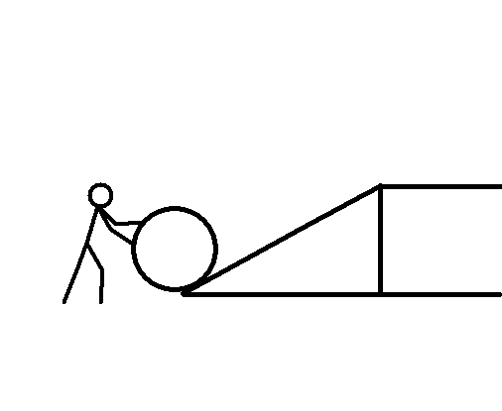
R
A
M
P
Types of Simple Machines
3
ramp

Slide 14
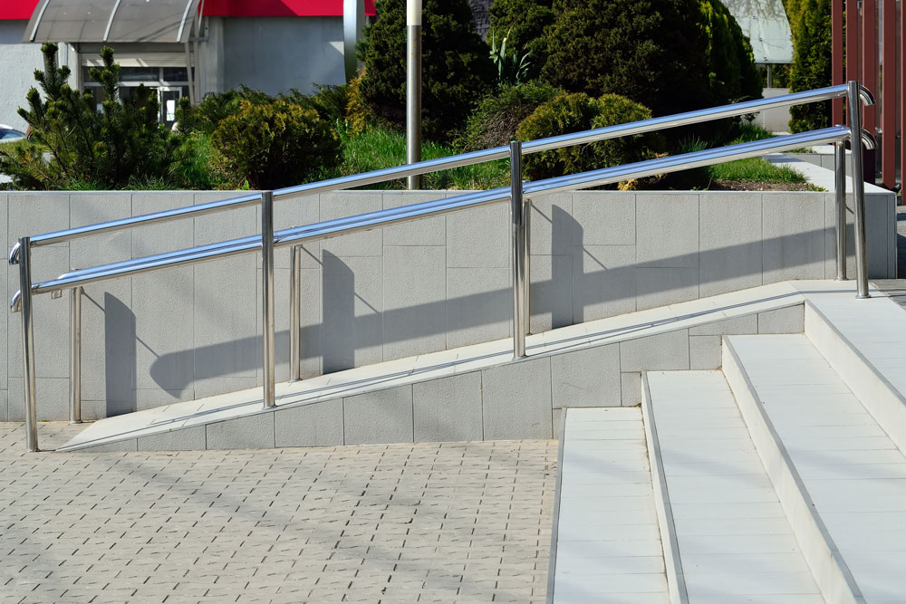

R
A
M
P
Types of Simple Machines
3

Slide 15


Slide 16
QUIZ TIME !
Question #1:
What is a pulley?
Answer:
It is a rope that moves over a
wheel.

Slide 17
QUIZ TIME !
Question #2:
What is a lever?
Answer:
It is a bar that balances on a
fixed point.

Slide 18
QUIZ TIME !
Question #3:
What is a ramp?
Answer:
It is a slanted surface.

Slide 19
QUIZ TIME !
Question #4:
What is a pulley used for?
Answer:
It is used to lift heavy objects
easily.

Slide 20
QUIZ TIME !
Question #5:
What two important things make
up a lever?
Answer:
A bar and a fixed point.

Slide 21
QUIZ TIME !
Question #6:
How is a ramp useful to us?
Answer:
We can use it to move things up
or down easily.

